Slide 1

Browser game: Tetris Final presentation
Flavio Medina
Philipp Prica
Benno Vuong

Slide 2

User Stories: what we imagined
As a user, I want to
Play a game of Tetris
Be able to login and logoff
Save my scores and compare them to other high scores in a database
Change the difficulty of the game
Play against another person (Local Multiplayer)

Slide 3



User Stories: what we have accomplished
As a user, I want to
Play a game of Tetris
Be able to login and logoff
Save my scores and compare them to other high scores in a database
Change the difficulty of the game
Play against another person (Local Multiplayer)
New game modes

Slide 4

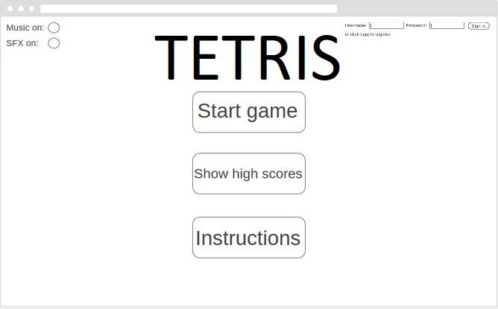
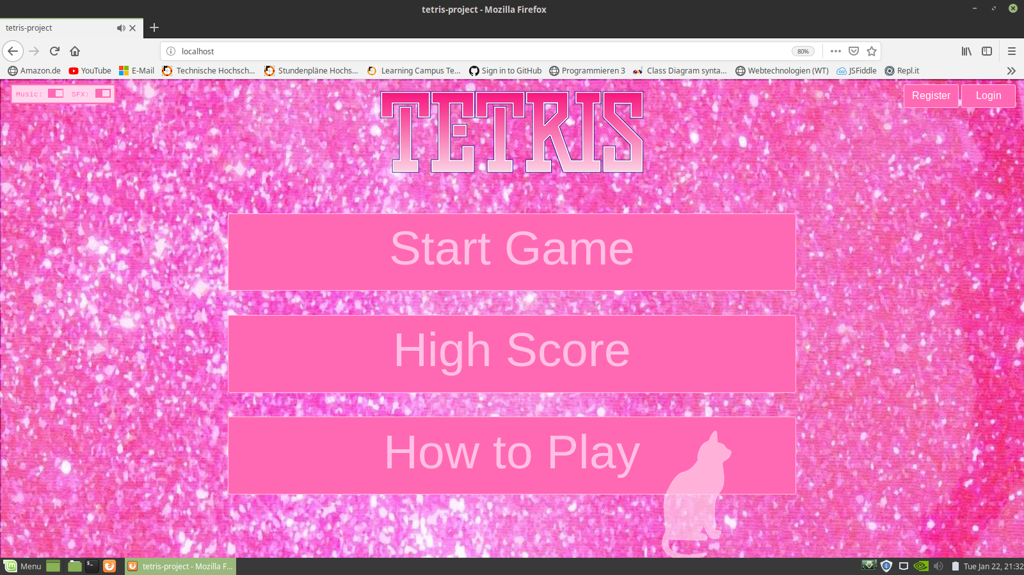
Comparison between wireframe and real version

Slide 5
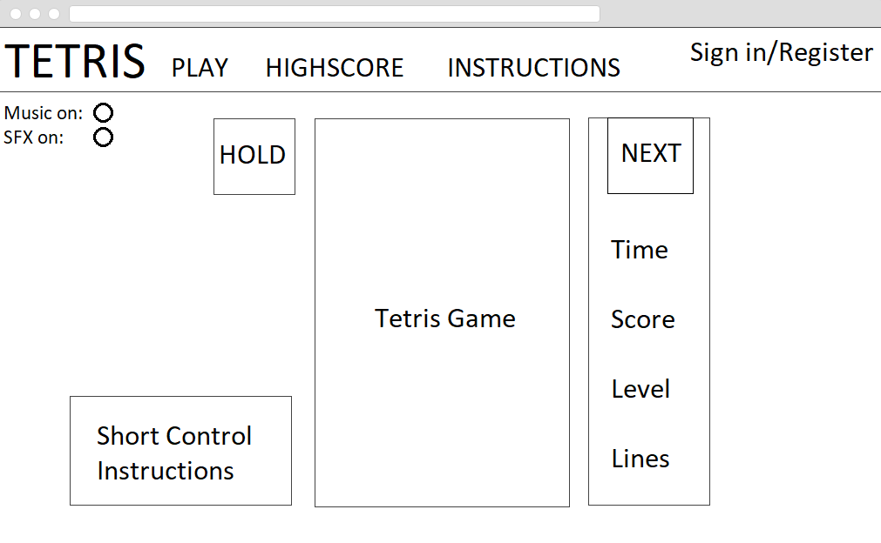
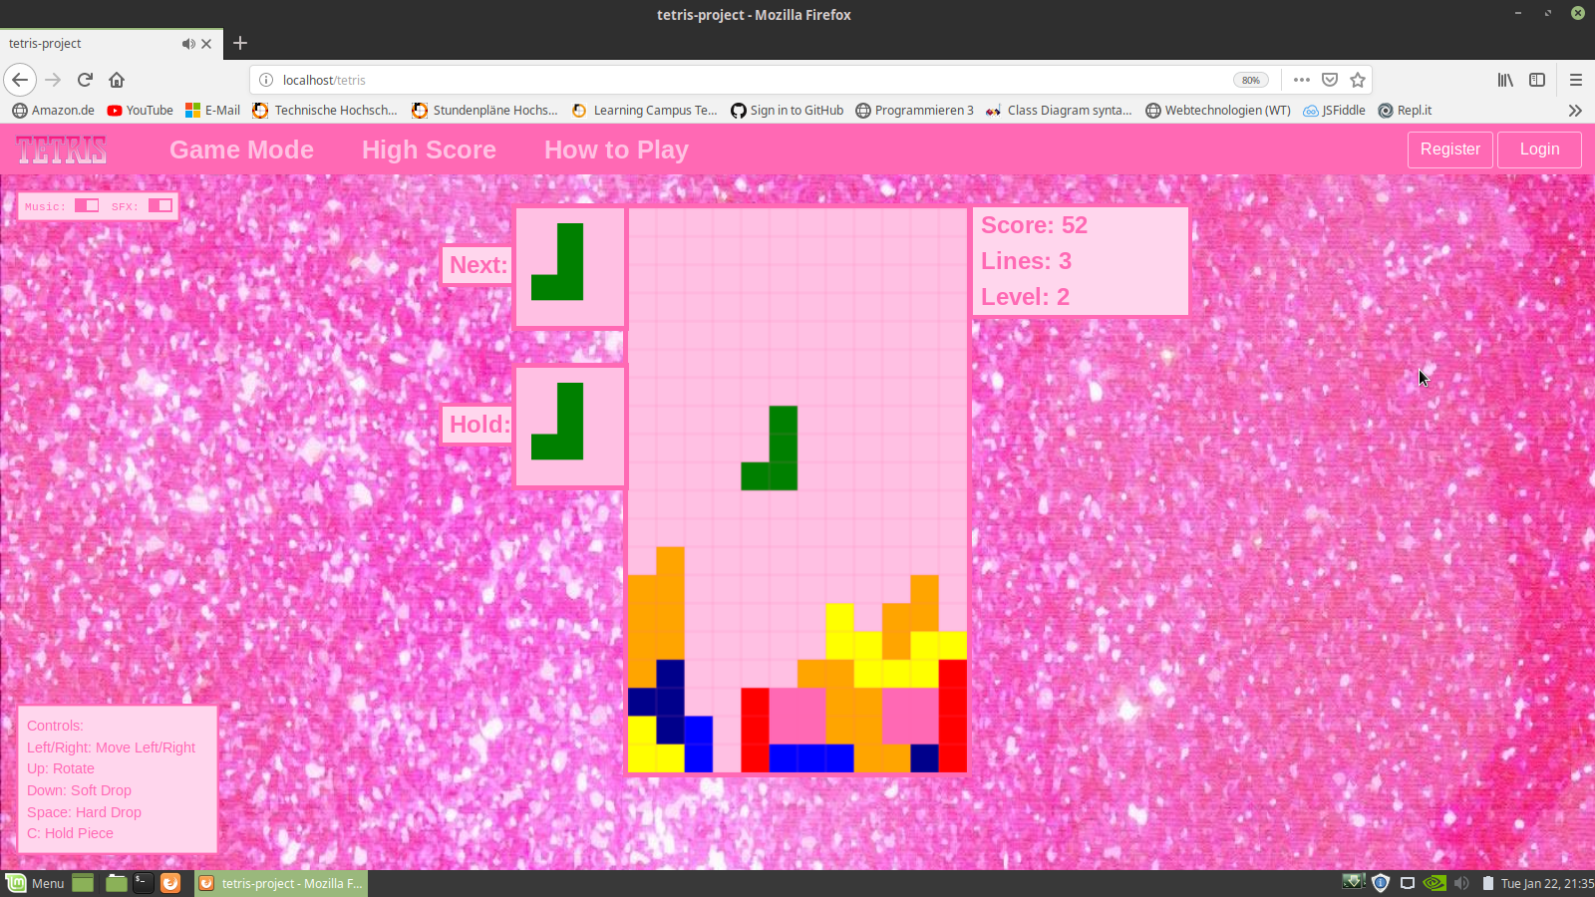
Comparison between wireframe and real version

Slide 6







Used technologies

Slide 7
Live demo

